Slide 1

Through the Social Lens:
Improving Adobe’s Marketing Effort Accuracy
Presented By:
Victoria Capobianco
Ziyao Cui
Eric Hong
Joshua Rotuna
Advisor: Dr. Kala Seal
Adobe Sponsor: Ryan Komagome

Slide 2
Agenda
Agenda
1
Business & Project Background
2
Investigation & Methodology
3
Conclusion & Learning

Slide 3
Business & Project Background

Slide 4





Business Background
Leader in Photo & Video Editing Industry
Adobe: Creative Software
Photoshop
Lightroom
Premiere Pro
Premiere Rush
Acrobat
Recent Attention: Increased competition and diminishing returns on acquisition marketing campaigns

Slide 5
Problem Statement
Improve Adobe’s marketing effort accuracy through a thorough analysis of their social mentions, sales variance, and industry patterns to enhance the current Marketing Mix Model and indicate their growth within the Photo & Video Editing Sector
Notes:
How is Adobe acting among the larger Photo & Video Editing Industry
Is there a relationship between social mentions and sales?
Is that relationship strong enough to make a prediction?

Slide 6
Project Questions
How is Adobe acting among larger Photo & Video Editing Industry?
What common conversations are happening on social media within the industry?
Is there a relationship between social mentions and sales?
Is that relationship strong enough to make a sales prediction?
What other factors, beyond social mentions, could inform sales?
Notes:
-animate

Slide 7



Analysis
Roadmap
Topics as Dummy Variables
Correlation Analysis
Analyze specific conversations
Topic Modeling
Regression Model
Internal Marketing Mix Model
Notes:
-text white->or change background
-flyer part 1

Slide 8
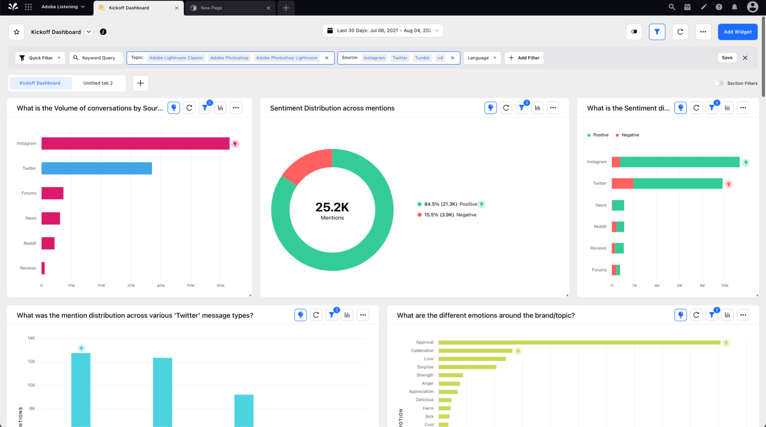
Sprinklr Example

Slide 9
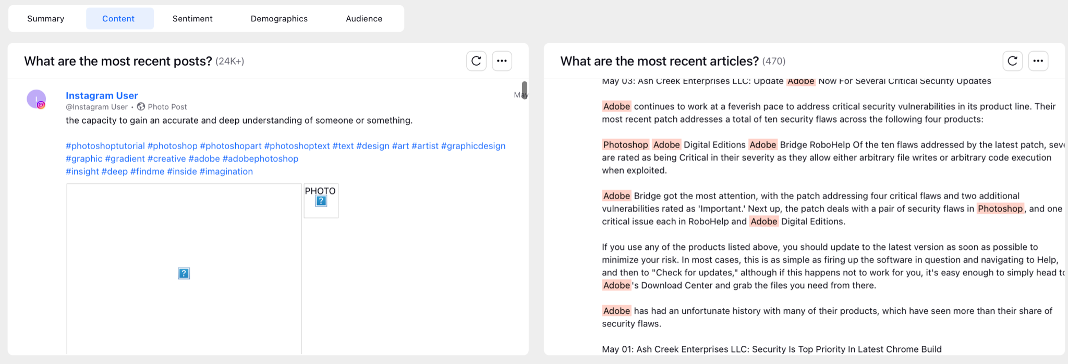
Sprinklr Example
(continued)

Slide 10
2. Investigation & Methodology

Slide 11
External Factors
Correlation Analysis
Internal Marketing Mix Model
Data Exploration & Correlation Analysis
Notes:
-text white->or change background
-flyer part 1

Slide 12
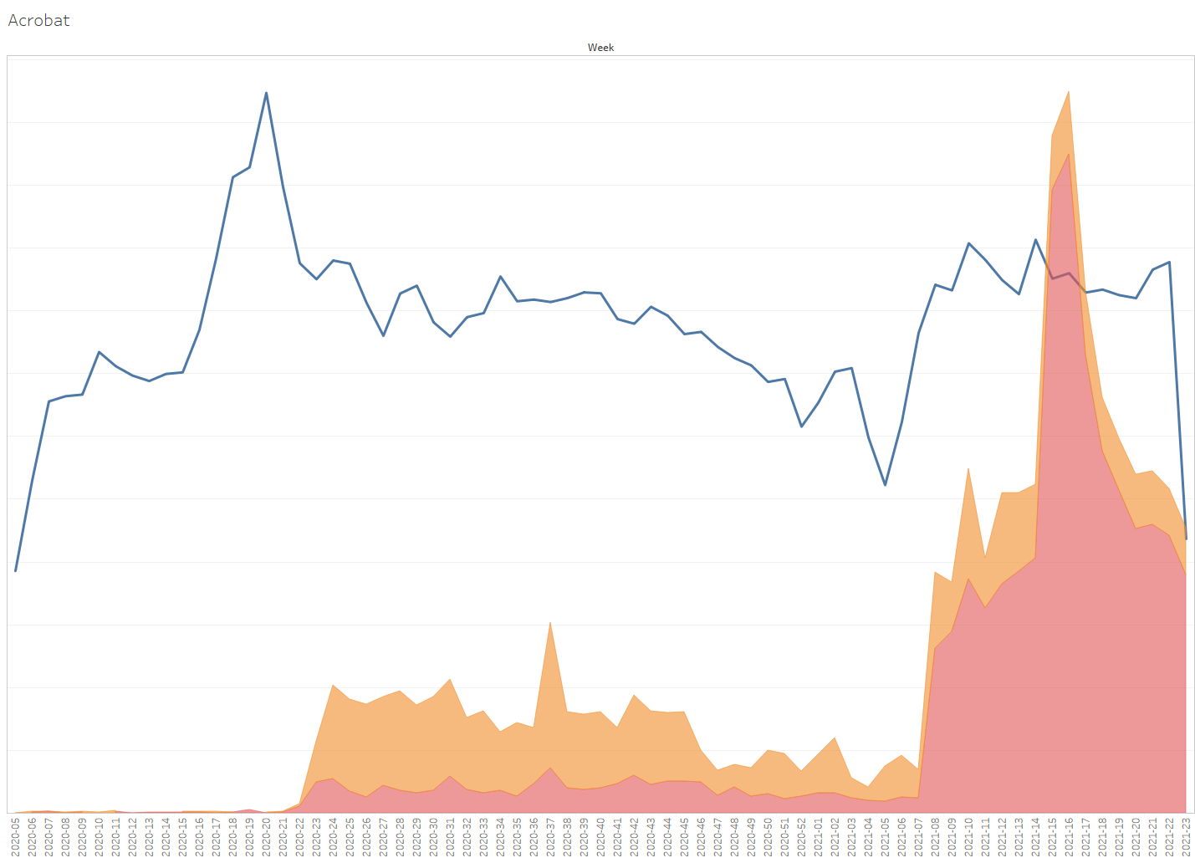
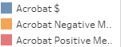
Exploratory Visualizations
Weekly Sales Trend Over Time
Mid 2020
Millions
Notes:
Add dollar amount Tableau
Sales Trend Over Time/Weekly Sales
Trend sentiment vs sales

Slide 13
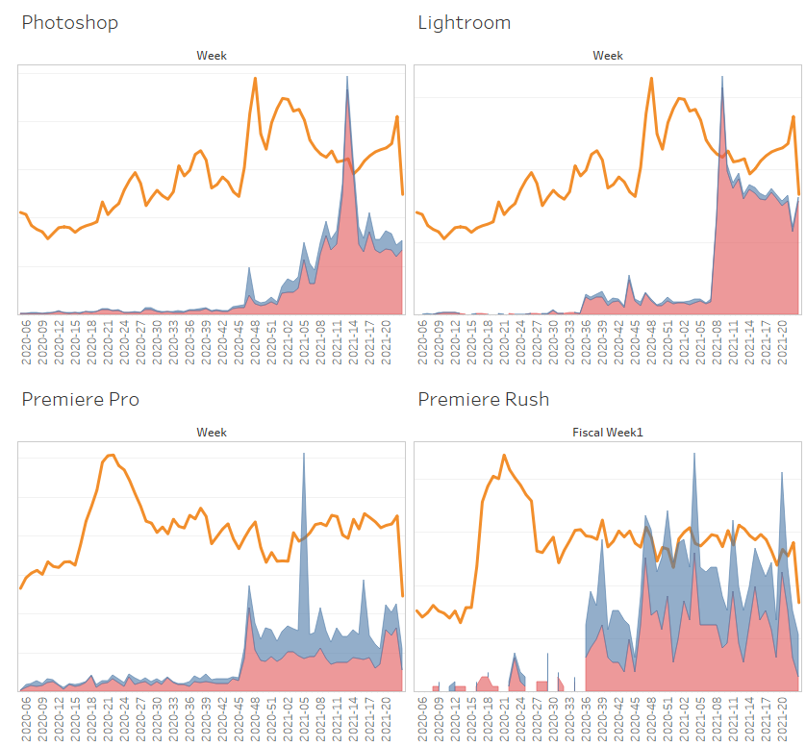
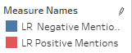
Weekly Sales Of Four Products
Notes:
-add graph titles

Slide 14
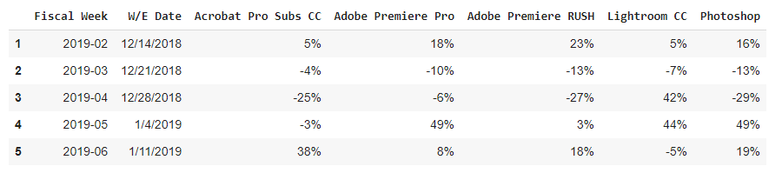
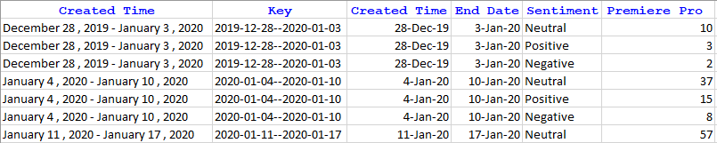
Developing Data Stream
Sales Variance
Data from Sprinklr
Notes:
-sentiment spike towards end of year->scraped data from sprinklr, transform in excel
Sprinklr, combine
Adstock corr, dollar amount
-label 2.80
-lessen decimal places on Corr
-break into two slides
-adstock equation->transition into data

Slide 15
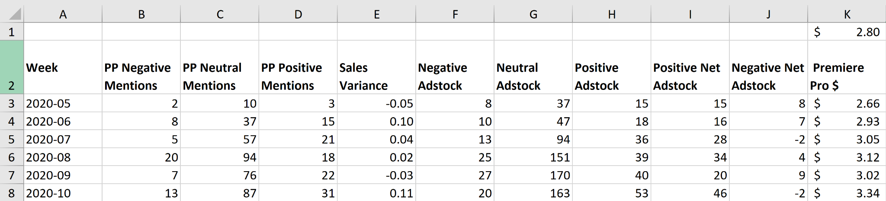
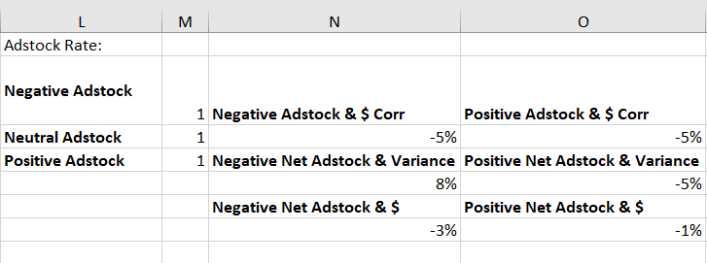
Adstock:
At = Xt + adstock rate * At-1

Slide 16
Exploratory Correlation Analyses
Social Mentions
Correlation of individual Adobe product with different types of sentiments on the mentions based on industry keyword
Weekly Lags of sentiment
Up to 8 weeks
Adstock
Weekly Lags

Slide 17
Analysis
Roadmap
Correlation Analysis
Regression Model
Data Stream
Internal Marketing Mix Model

Slide 18
External Factors
Correlation Analysis
Topic Modeling
Data Stream
Internal Marketing Mix Model
Topic Modeling
Notes:
-text white->or change background
-flyer part 1

Slide 19
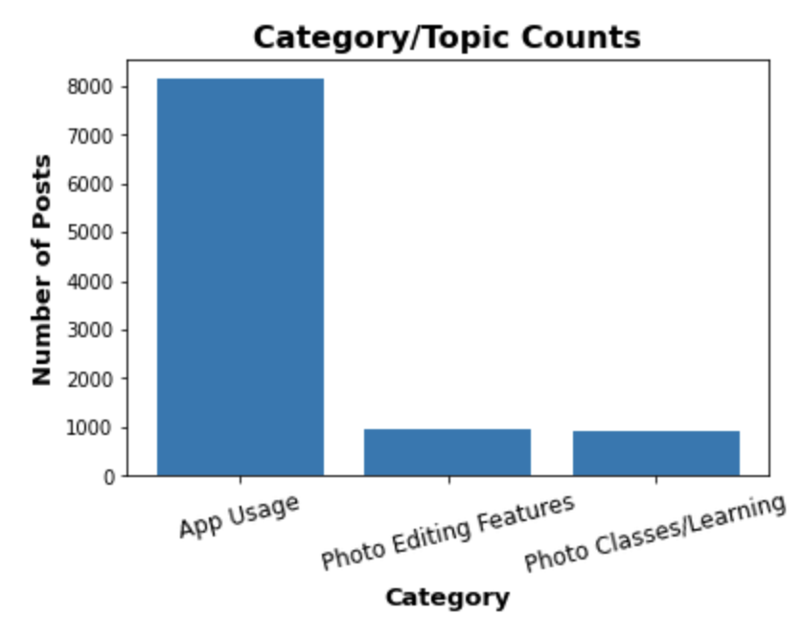
NMF Topic Modeling
Data from 2020
Twitter & Web Posts
Created Three Topic Groups

Slide 20

LDA Topic Modeling
Constructed Three Groups:
Promotional Posts
Spam Messages
Adobe Product Users

Slide 21
Correlation Analysis
Topic Modeling
Regression Model
Data Stream
ID Spam Mentions
Internal Marketing Mix Model
Regression Model
Notes:
-text white->or change background
-flyer part 1

Slide 22
Data Collection
Covid Data
Competitor Sentiments
Canva
Final Cut Pro
Davinci Resolve
Sentiment
Ratios

Slide 23
Feature Selection
Importance
Overfitting
Too many features
Model inapplicable for other samples
Multicollinearity
Lessens the significance of independent variables

Slide 24
Methods used for Feature Selection
Backward Elimination
Manual Selection
PostoNegPercent = Pos Sentiment / (Pos+Neg Sentiment)

Slide 25
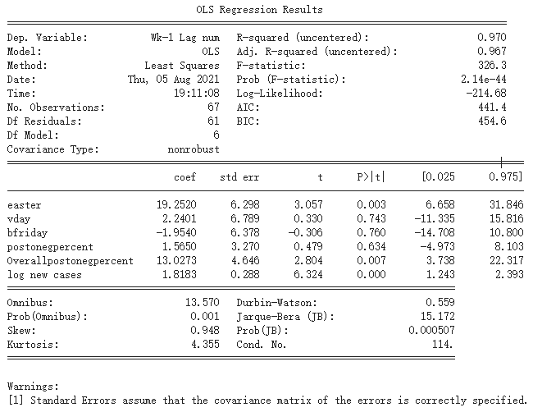
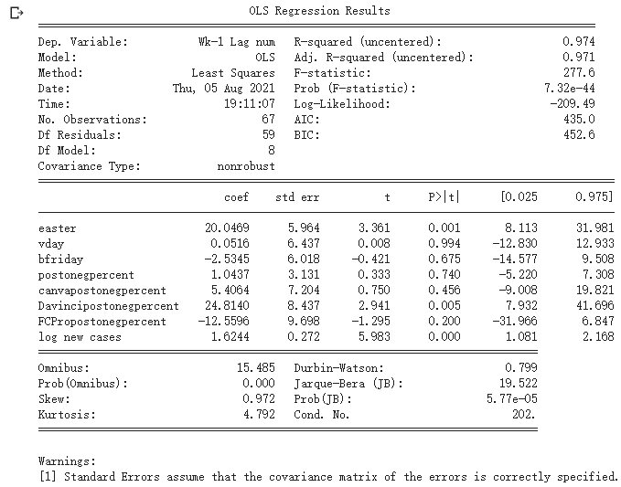
Best Performing Models
MAE: 4.369
MAE: 4.351

Slide 26
Correlation Analysis
Topic Modeling
Regression Model
Data Stream
ID Spam Mentions
Future MMM Variables
Marketing Mix Model
Internal Marketing Mix Model
Notes:
-text white->or change background
-flyer part 1

Slide 27
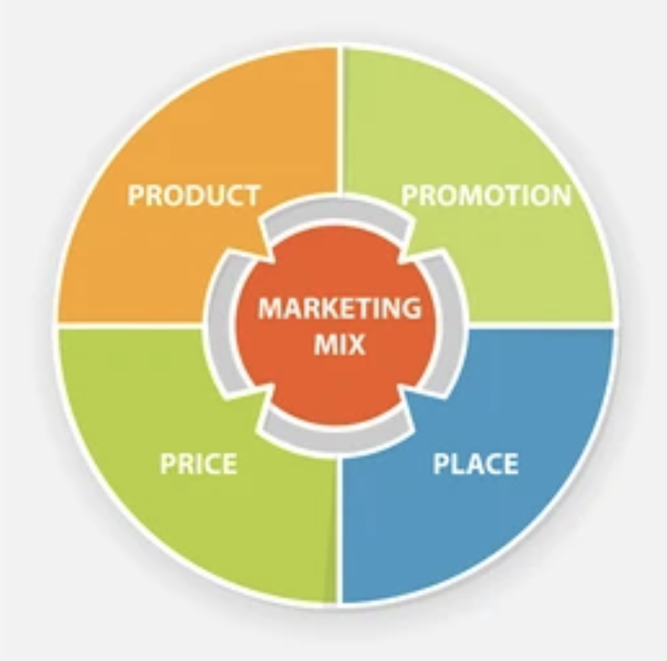
Marketing Mix Model
Based on multivariate regression models
Captures impact of marketing techniques
Most Common KPI’s compared against are Sales or Revenue

Slide 28
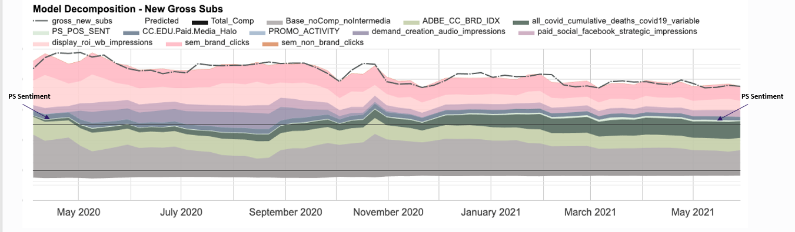
MMM Decomposition
Notes:
-flyer #2

Slide 29
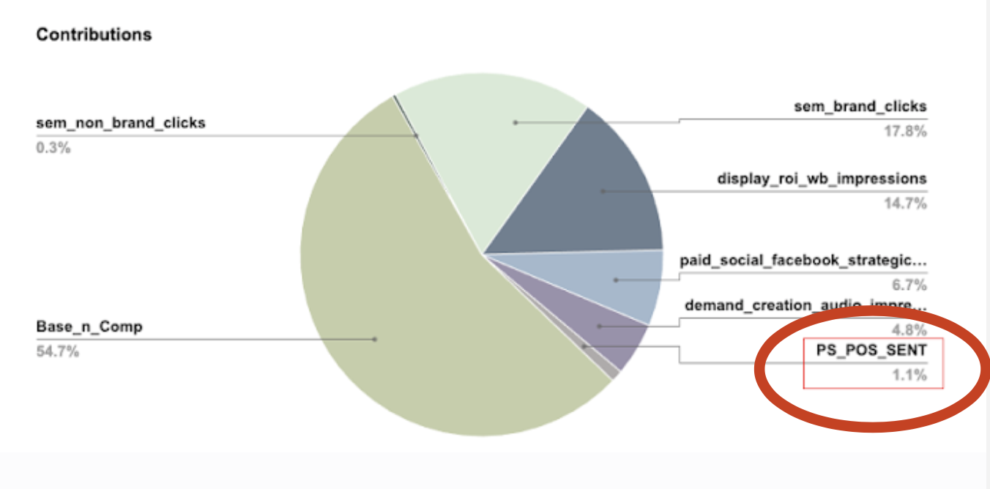
MMM Contributions & Results
Notes:
-separate slides

Slide 30
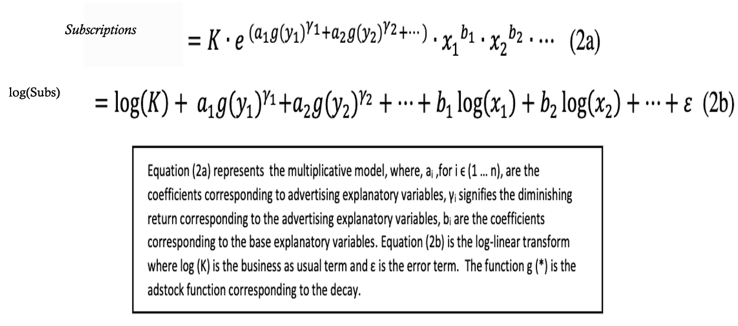
Adobe’s MMX Equation
Accounts for synergistic impact
Provides an ROI by media channel
Prevent structure bias

Slide 31
3. Conclusion & Learning

Slide 32
Original
Analysis
Roadmap
Topics as Dummy Variables
Correlation Analysis
Analyze specific conversations
Topic Modeling
Regression Model
Internal Marketing Mix Model
Notes:
-text white->or change background
-flyer part 1

Slide 33
Actual
Analysis
Roadmap
Correlation Analysis
Topic Modeling
Regression Model
Data Stream
ID Spam Mentions
Future MMM Variables
Internal Marketing Mix Model
Notes:
-text white->or change background
-flyer part 1

Slide 34
Adobe’s Future Use:
Data stream as explanatory variable within MMM
Continue to track and grow social data
Additional data modeling
Test for stronger impact
Automate data feed for continued use in models

Slide 35
A Word From Our Adobe Sponsors

Slide 36
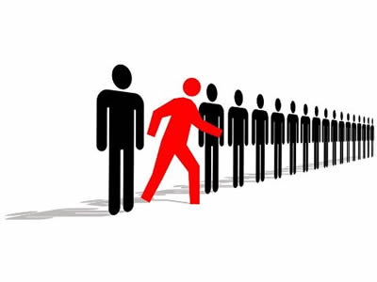


Recommendations for Future Cohorts
Notes:
-Don’t be afraid to take initiative->especially
-Ask Questions0>to your teammates, advisor, and project sponsor
-Strong communication is key!

Slide 37

A Special Thank You To:
Ryan Komagome
Alberto Castillo
Pat Brown
Dr. Kala Seal
MSBA Teachers & Faculty
Fellow 2021 MSBA Cohort

